Slide 1


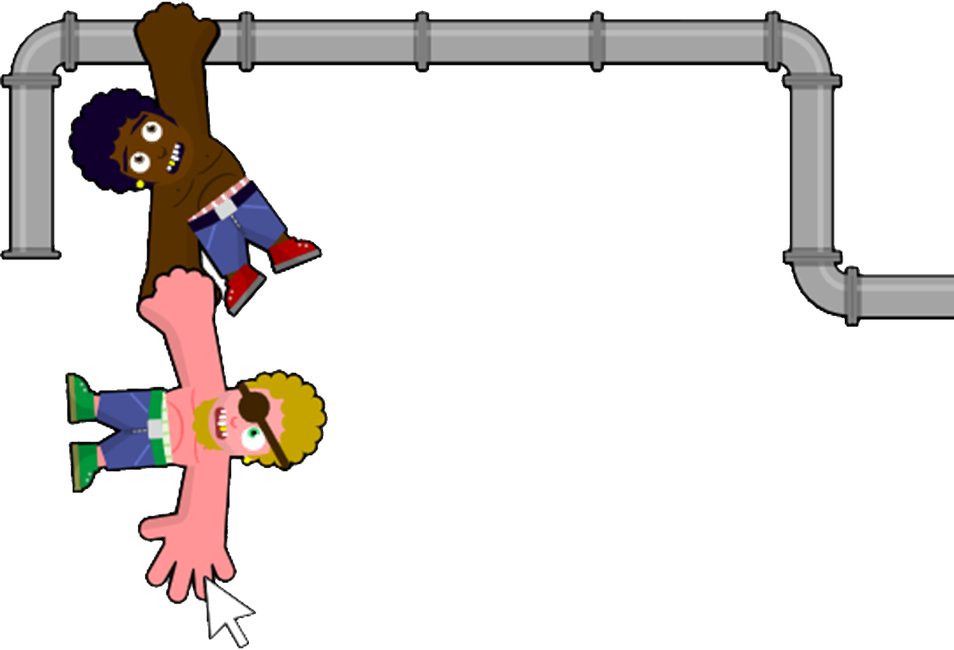



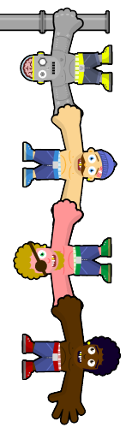



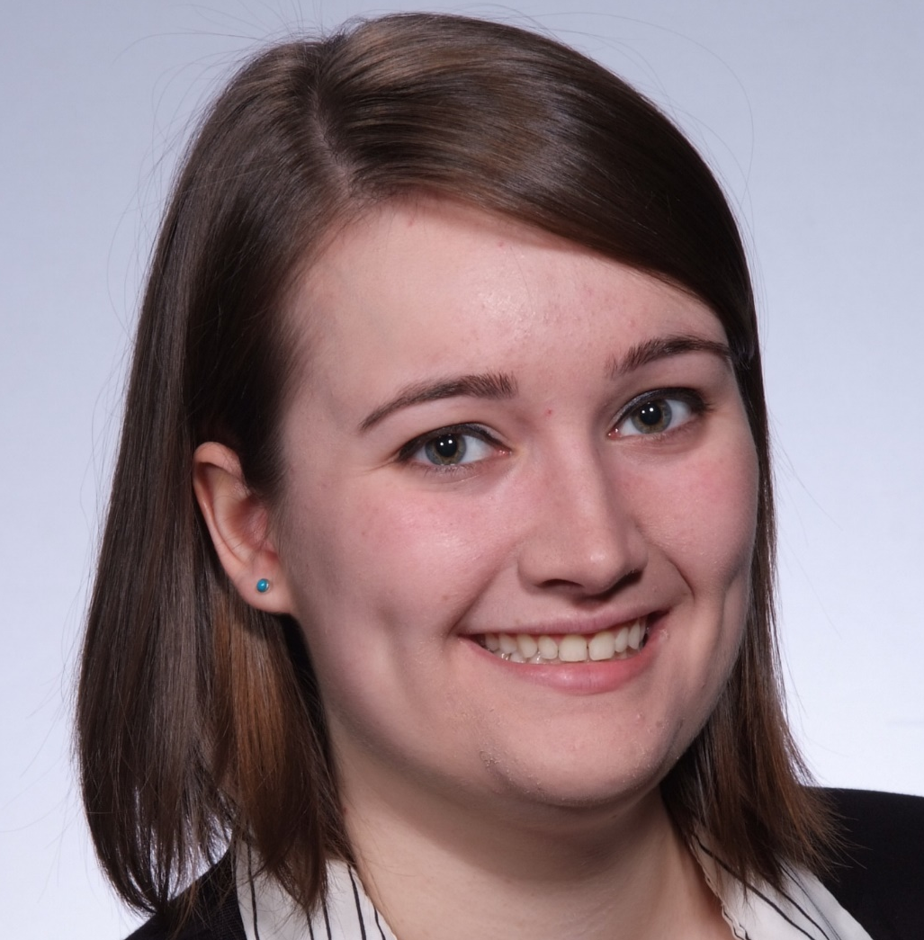
Don’t Let Go, Bro
REPLACE THIS BOX WITH YOUR ORGANIZATION’S
HIGH RESOLUTION LOGO
Christian Bouwense, Steph Oro
Adam Gincel, Alex Massenzio, Robyn Verrill
Project Details
Methods and Materials
Discussion
Department: Computer Science
Advisor: Professor Klappholz
Client: Mark Nelson
Discussion on our code and our process?
Click here to insert your Discussion text. Type it in or copy and paste from your Word document or other source.
This text box will automatically re-size to your text. To turn off that feature, right click inside this box and go to Format Shape, Text Box, Autofit, and select the “Do Not Autofit” radio button.
To change the font style of this text box: Click on the border once to highlight the entire text box, then select a different font or font size that suits you. This text is Calibri 32pt and is easily read up to 5 feet away on a 36x48 poster.
Introduction
Results
Conclusions
Genigraphics® has provided this template to assist in preparation of a medical or scientific research poster. The dimensions are set to 36” high by 48” wide and the layout is for use as a Tri-Fold poster.
The poster is designed to fold at 12” in from the sides so it can be stored or shipped at 36” high by 24” wide. The folds align precisely in between the columns.
Order your poster from Genigraphics and we will perform a free design review and advise you if we see anything that may be a concern for printing. We’ll even help tidy things up.
We have more history with PowerPoint® than any other printing company. In fact, we helped Microsoft® design the software and we created all of the original color themes, templates, and clip art galleries. We know how to make your printed poster look just like it does on screen. Other printing companies and copy centers will blindly convert your file to another format prior to printing. This can result in text shifting, symbols changing, and altered colors. We know the secrets to avoid those issues. So choose Genigraphics for the most accurate reproduction available.
Where the project can go from here??
Click here to insert your Conclusions text. Type it in or copy and paste from your Word document or other source.
This text box will automatically re-size to your text. To turn off that feature, right click inside this box and go to Format Shape, Text Box, Autofit, and select the “Do Not Autofit” radio button.
To change the font style of this text box: Click on the border once to highlight the entire text box, then select a different font or font size that suits you. This text is Calibri 32pt and is easily read up to 5 feet away on a 36x48 poster.
Zoom out to 100% to preview what this will look like on your printed poster.
Chart 1. Label in 24pt Calibri.
Future Directions
Click here to insert your Future Directions text. Type it in or copy and paste from your Word document or other source.
This text is Calibri 32pt and is easily read up to 5 feet away on a 36x48 poster.
Christian Bouwense
Alex Massenzio
Adam Gincel
Steph Oro
Robyn Verrill

